Slide 1


Thando Mothle
10-12-2024

Slide 2

Outline
Executive Summary
Introduction
Methodology
Results
Conclusion
Appendix

Slide 3
Executive Summary
Summary of methodologies
Summary of all results

Slide 4
Introduction
Project background and context
Problems you want to find answers

Slide 5

Section 1

Slide 6
Methodology
Executive Summary
Data collection methodology:
Describe how data was collected
Perform data wrangling
Describe how data was processed
Perform exploratory data analysis (EDA) using visualization and SQL
Perform interactive visual analytics using Folium and Plotly Dash
Perform predictive analysis using classification models
How to build, tune, evaluate classification models

Slide 7
Data Collection
The data was collected by making a request to the SpaceX API
This was done by making use of the URL that contained the rocket launch data from the SpaceX API and using the GET request
The data obtained was normalized and converted into a data frame
Using the data obtained, a dataset was constructed using the Pandas data frame
With this newly obtained Pandas data frame, multiple useful methods could be applied to the data such as the head function.
The data frame was further filtered to include only a desired set of data

Slide 8
Data Collection – SpaceX API
Request Data from
the SpaceX Rest API
Receive a
Response
Create and store
in a data frame
Request Rocket Data,
Launchpad Data,
Payloads Data and
Cores Data from
the SpaceX Rest API
Create and save
them in a
Dictionary
Receive a
Response
Create and store
in a data frame
Github URL:

Slide 9
Data Collection - Scraping
Perform HTTP
Request from
Wikipedia’s page
Receive an
HTTP
Response
Create and save
it in a BeautifulSoup
Object
Parse the
launch HTML
tables
Create and save
them in a
Dictionary
Extract the column
names
Create and store
in a data frame
Github URL:

Slide 10
Data Wrangling
The approach to Data Wrangling was to address the missing values in the data set
This was achieved by initially determining the percentage of missing values in each attribute
The next step was to identify which columns were numerical and which were categorical
One hot encoding was applied to classify some of the categorical data

Slide 11
EDA with Data Visualization
The visualization plots used include Scatter Plots, Bar Charts, and Line Plots.
The Scatter Plots were used to visualize the relationship between Flight Number and Launch Site. They were used to visualize the relationship between Payload Mass and Launch Site. Scatter Plots were further utilized to visualize the relationship between Flight Number and Orbit. Lastly, scatter plots were used to visualize the relationship between Payload Mass and Orbit
The Bar Chart was used to visualize the relationship between the Success Rate and Orbit
The Line Plot was used to visualize the Launch Success yearly trend

Slide 12
EDA with SQL
The SQL queries performed include:
Displaying the names of unique launch sites in the space mission
Displaying 5 records where launch sites begin with ‘CCA’
Displaying the total payload mass carried by boosters launched by NASA
Displaying the average payload mass carried by booster F9 v1.1
Listing the date of the first successful landing in ground pad
Listing the names of boosters with successes in drone ship and a payload mass between 4000 and 600
Listing the total number of successful and failed mission outcomes
Using a subquery to list the names of booster versions that have carried the maximum payload mass
Listing the records with month names, failed landing outcomes in drone ship, booster versions, launch sites for the months in 2015
Ranking the count of landing outcomes between 2010-06-04 and 2017-03-20 in descending order

Slide 13
Build an Interactive Map with Folium
The map objects utilized include circles, markers and a marker cluster.
Circles were used to visualize the locations on a map using coordinates.
Markers were used to visualize the locations on a map using coordinates
Marker clusters were used to simplify a map that contained many markers with the same coordinates
Utilizing these objects revealed useful insights into the data that would otherwise have not been obvious

Slide 14
Build a Dashboard with Plotly Dash
In this particular instance, the graphs used were a Pie Chart and a Scatter Plot.
The Pie Chart was used to render the total success launches of all launch sites or success launches for a specified launch site. Deductions to be made from this include being able to see which launch site had the largest success rate.
The Scatter Plot was used to render the relationship between the payload mass and the launch outcome to visually observe how the payload mass may be correlated with mission outcomes for selected sites and determine which payload ranges and booster versions had the highest launch success rate.

Slide 15
Predictive Analysis (Classification)
The first thing to do was to normalize the data.
The normalized data was then split into testing and training sets.
The training data was further divided into validation data and training data.
Developing the model included these algorithms: Logistic Regression, Support Vector Machine, Decision Trees and k-Nearest Neighbor.
A grid search object was built for each algorithm to find the best parameters of the model which is referred to as hyper parameters tuning.
This process was concluded by selecting the most accurate model.

Slide 16
Results
Exploratory data analysis results
The success rate, from 2013 and onwards, increased with great magnitude
Interactive analytics demo in screenshots
Predictive analysis results
The Support Vector Machine and k-Nearest Neighbor obtained a validation set accuracy of 83% and a sample accuracy of 77%

Slide 17

Section 2

Slide 18
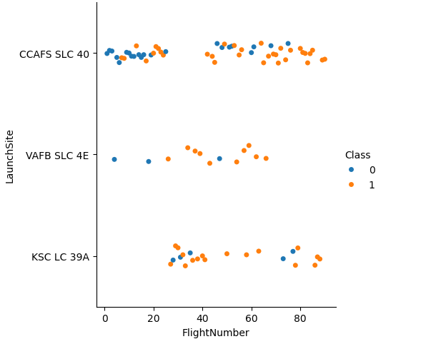
Flight Number vs. Launch Site

Slide 19
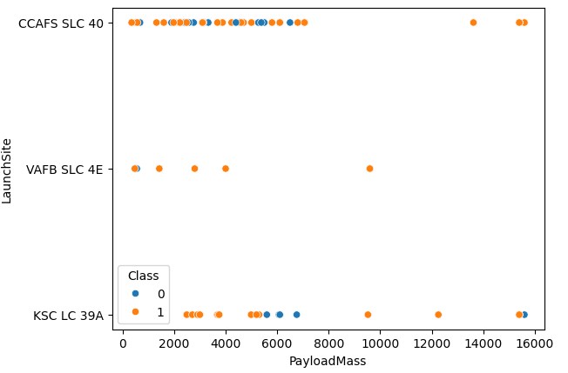
Payload vs. Launch Site

Slide 20
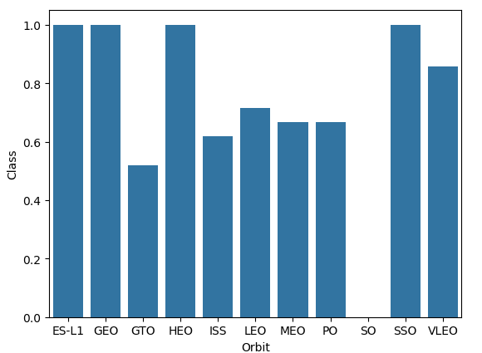
Success Rate vs. Orbit Type

Slide 21
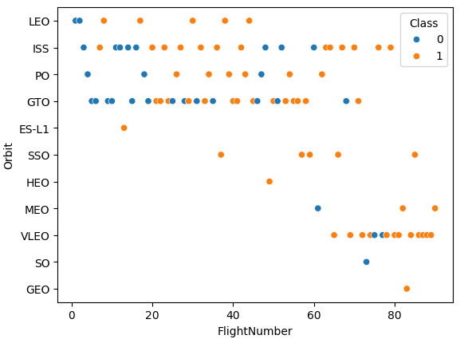
Flight Number vs. Orbit Type

Slide 22
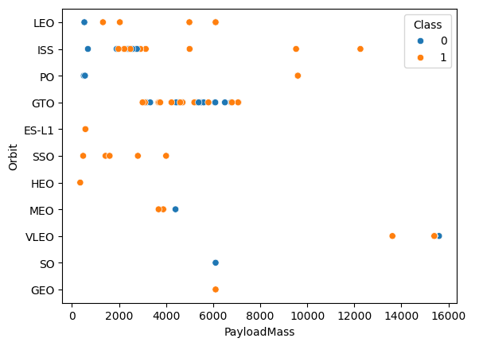
Payload vs. Orbit Type

Slide 23
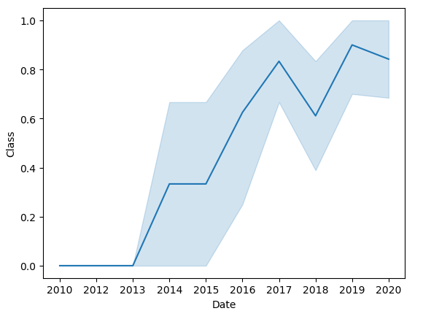
Launch Success Yearly Trend

Slide 24
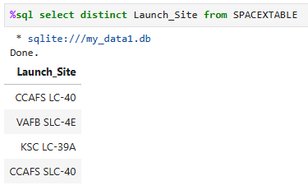
All Launch Site Names

Slide 25
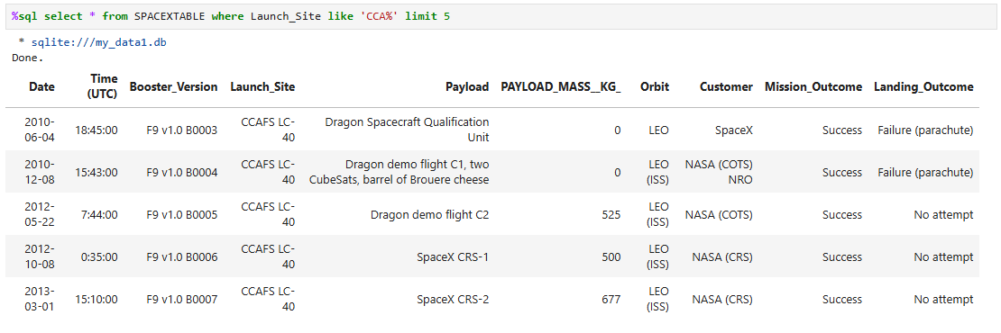
Launch Site Names Begin with 'CCA'

Slide 26
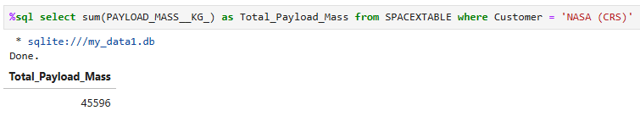
Total Payload Mass

Slide 27
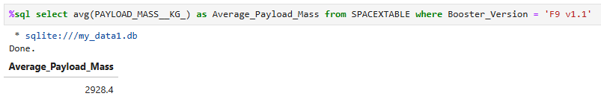
Average Payload Mass by F9 v1.1

Slide 28
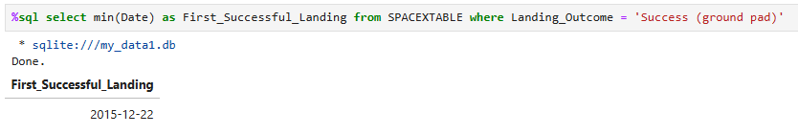
First Successful Ground Landing Date

Slide 29
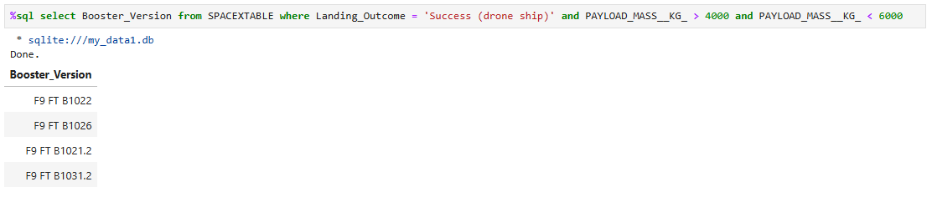
Successful Drone Ship Landing with Payload between 4000 and 6000

Slide 30
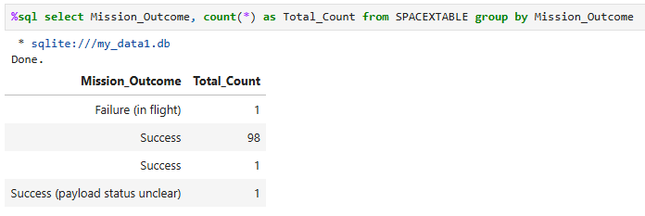
Total Number of Successful and Failure Mission Outcomes

Slide 31
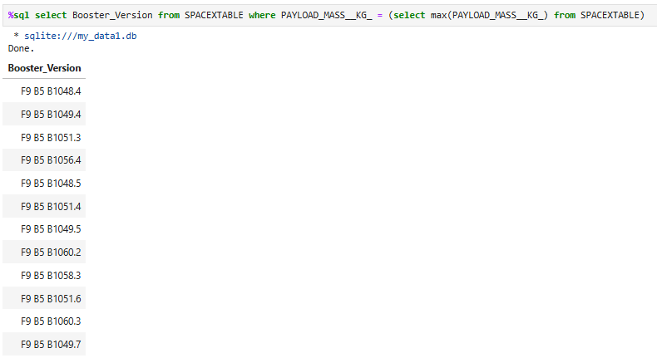
Boosters Carried Maximum Payload

Slide 32
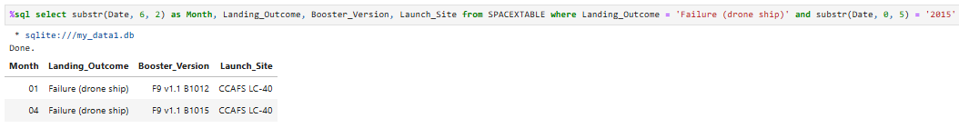
2015 Launch Records

Slide 33
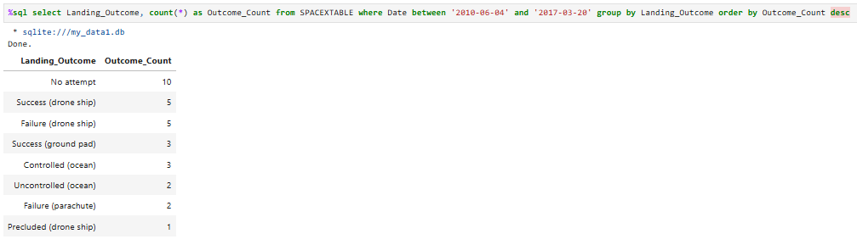
Rank Landing Outcomes Between 2010-06-04 and 2017-03-20

Slide 34

Section 3

Slide 35
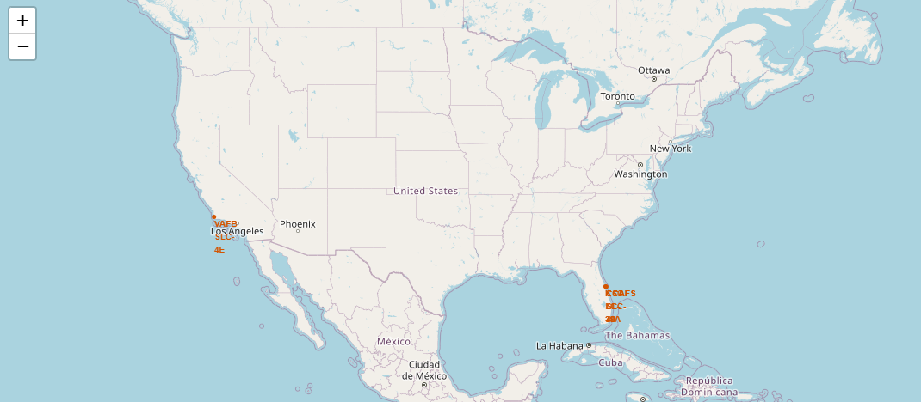
<Folium Map Screenshot 1>

Slide 36
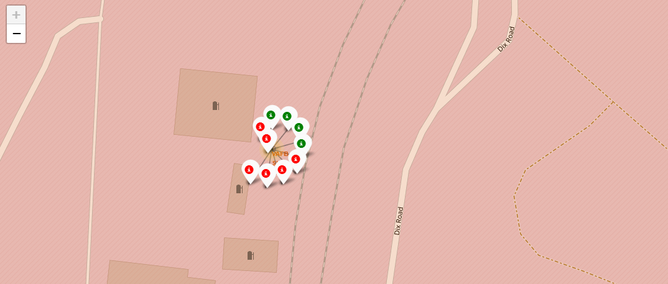
<Folium Map Screenshot 2>

Slide 37
<Folium Map Screenshot 3>
Replace <Folium map screenshot 3> title with an appropriate title
Explore the generated folium map and show the screenshot of a selected launch site to its proximities such as railway, highway, coastline, with distance calculated and displayed
Explain the important elements and findings on the screenshot

Slide 38

Section 4

Slide 39
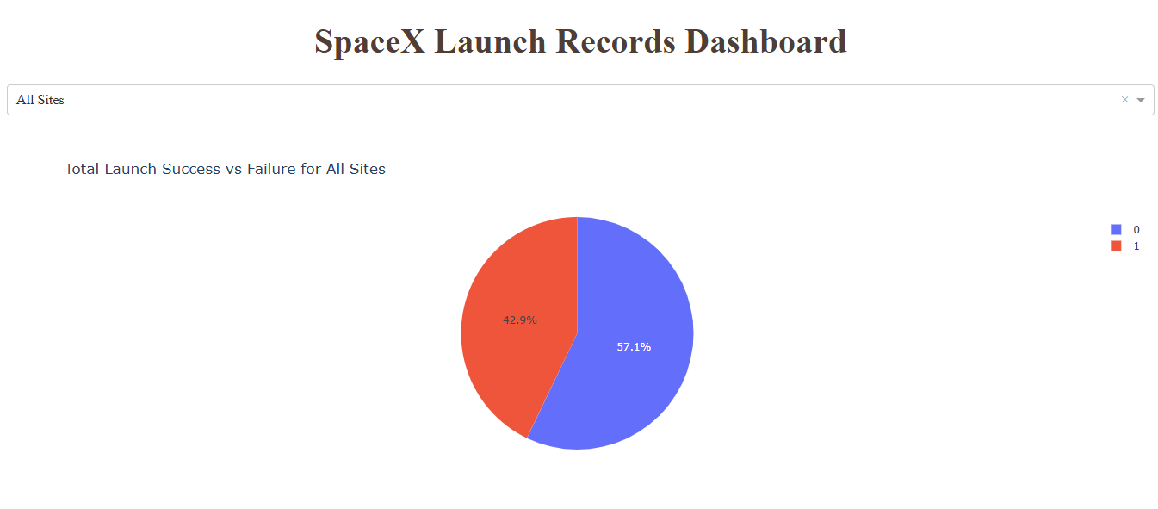
<Dashboard Screenshot 1>

Slide 40
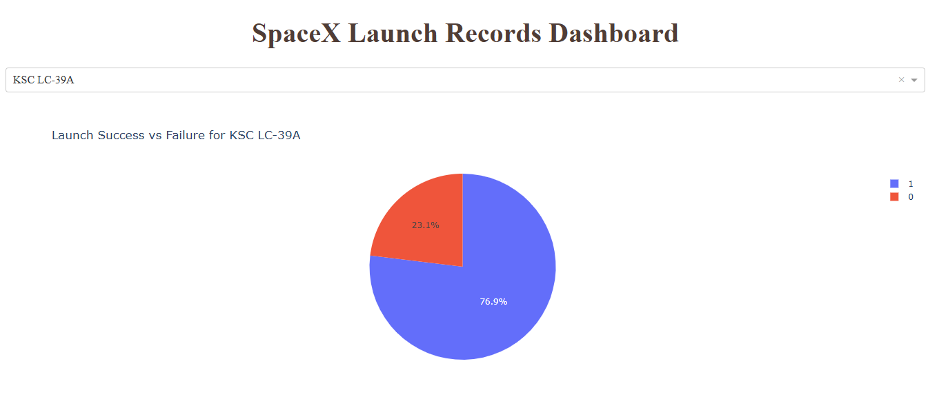
<Dashboard Screenshot 2>

Slide 41
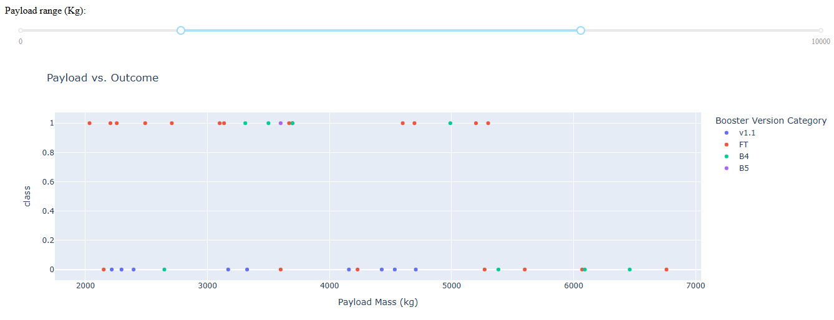
<Dashboard Screenshot 3>

Slide 42

Section 5

Slide 43
Classification Accuracy
Visualize the built model accuracy for all built classification models, in a bar chart
Find which model has the highest classification accuracy

Slide 44
Confusion Matrix
Show the confusion matrix of the best performing model with an explanation

Slide 45
Conclusions
D

Slide 46
Appendix
Include any relevant assets like Python code snippets, SQL queries, charts, Notebook outputs, or data sets that you may have created during this project

Slide 47


